Slide 1

Design and Development of data storage solutions for analysis
Dublin business school/masters/
Data Storage Solutions for Data Analytics

Slide 2

Introduction
The primary goal is to develop a data warehouse that serves as a centralized repository for integrated data, enabling stakeholders to make informed and data-driven decisions. The data warehouse will support reporting and analytics, fostering a culture of evidence-based decision-making within the organization.

Slide 3
Vision and Goals
Improve Sales and Revenue
Enhance Customer Experience
Optimize Inventory Management
Evaluate Staff Performance
Geographic Expansion
Key Stakeholders
Executive Leadership
Sales and Marketing Teams
Inventory Management
Human Resources
Finance

Slide 4

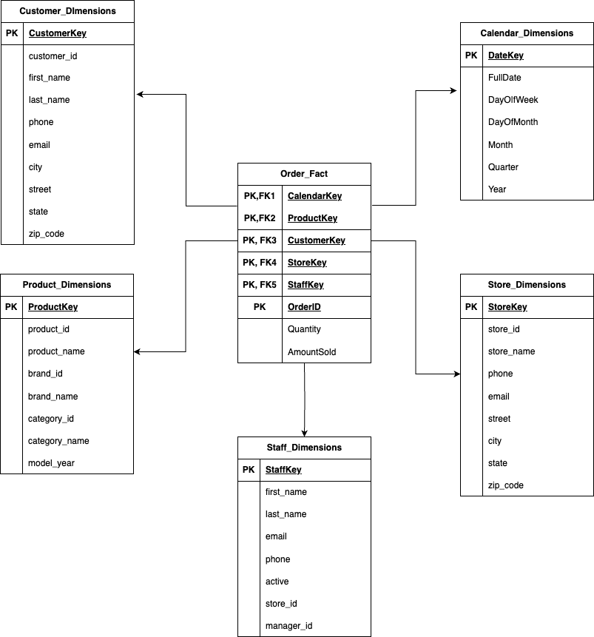



SCHEMA
We selected this model for the following reasons:
Simplicity and Readability
Query Performance
Flexibility for Reporting
Support for Aggregation
Dimensional model for the data warehouse.

Slide 5
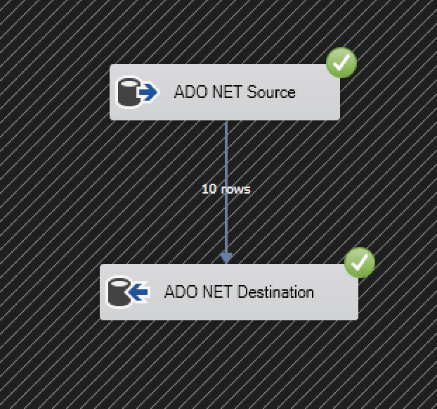
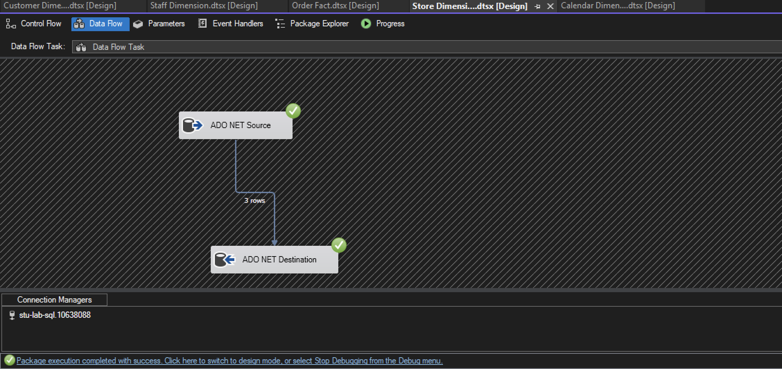
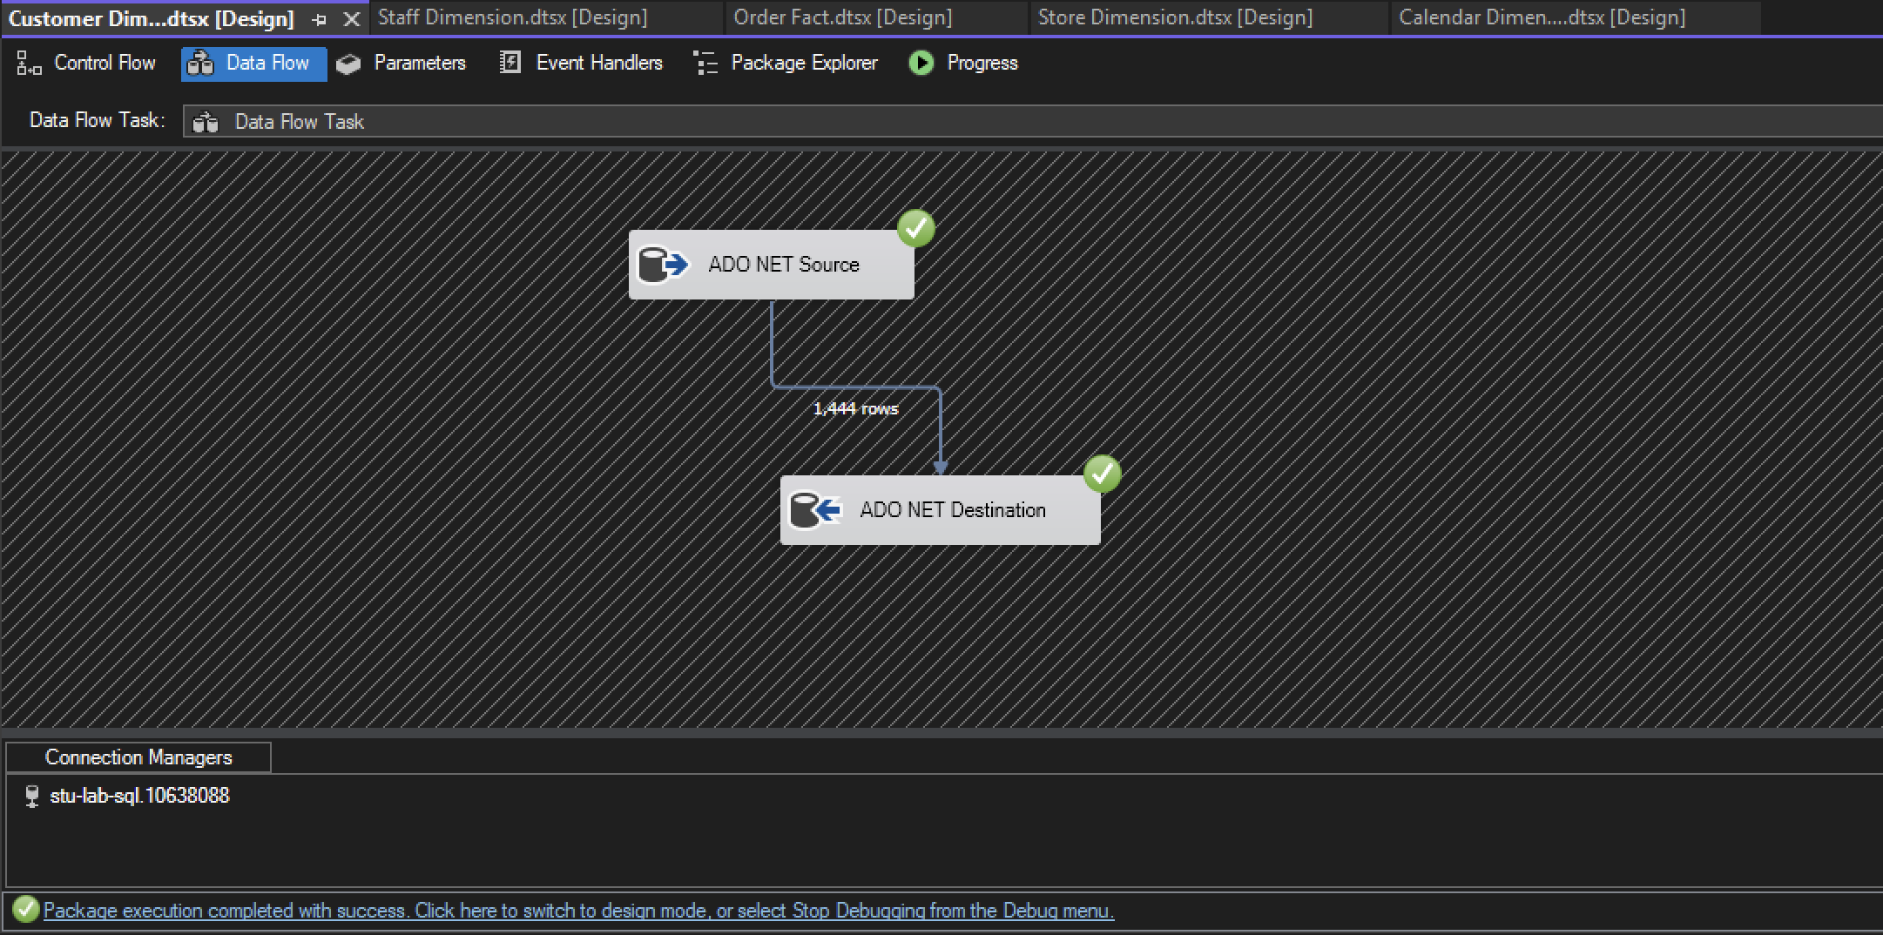
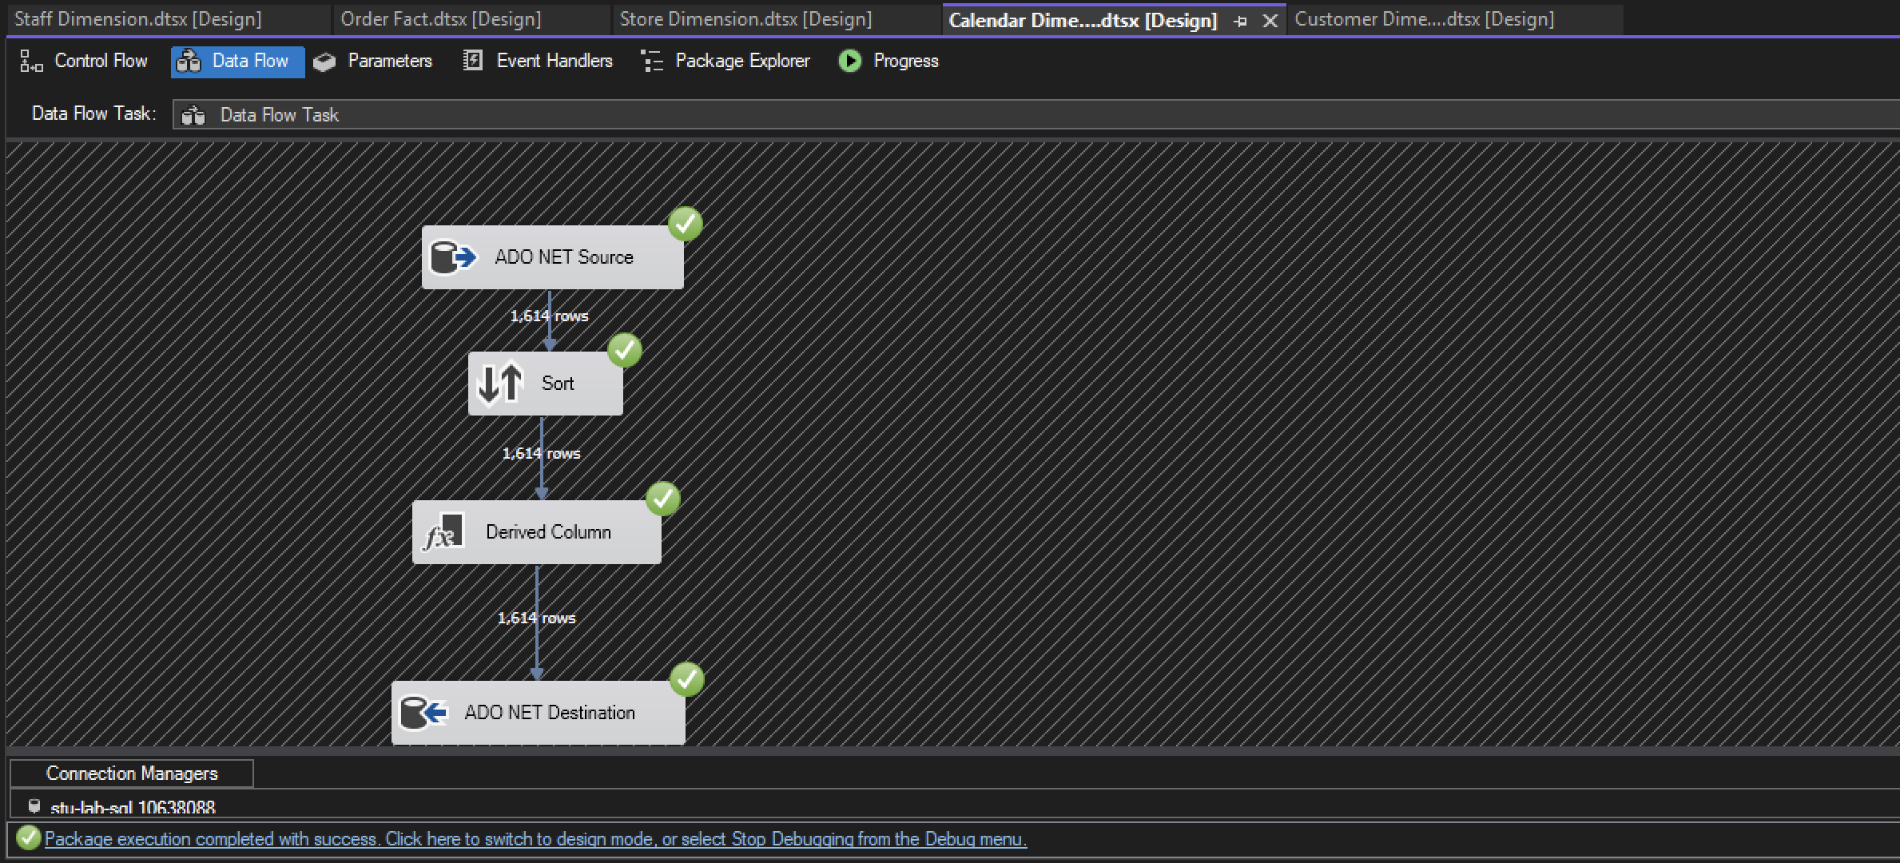
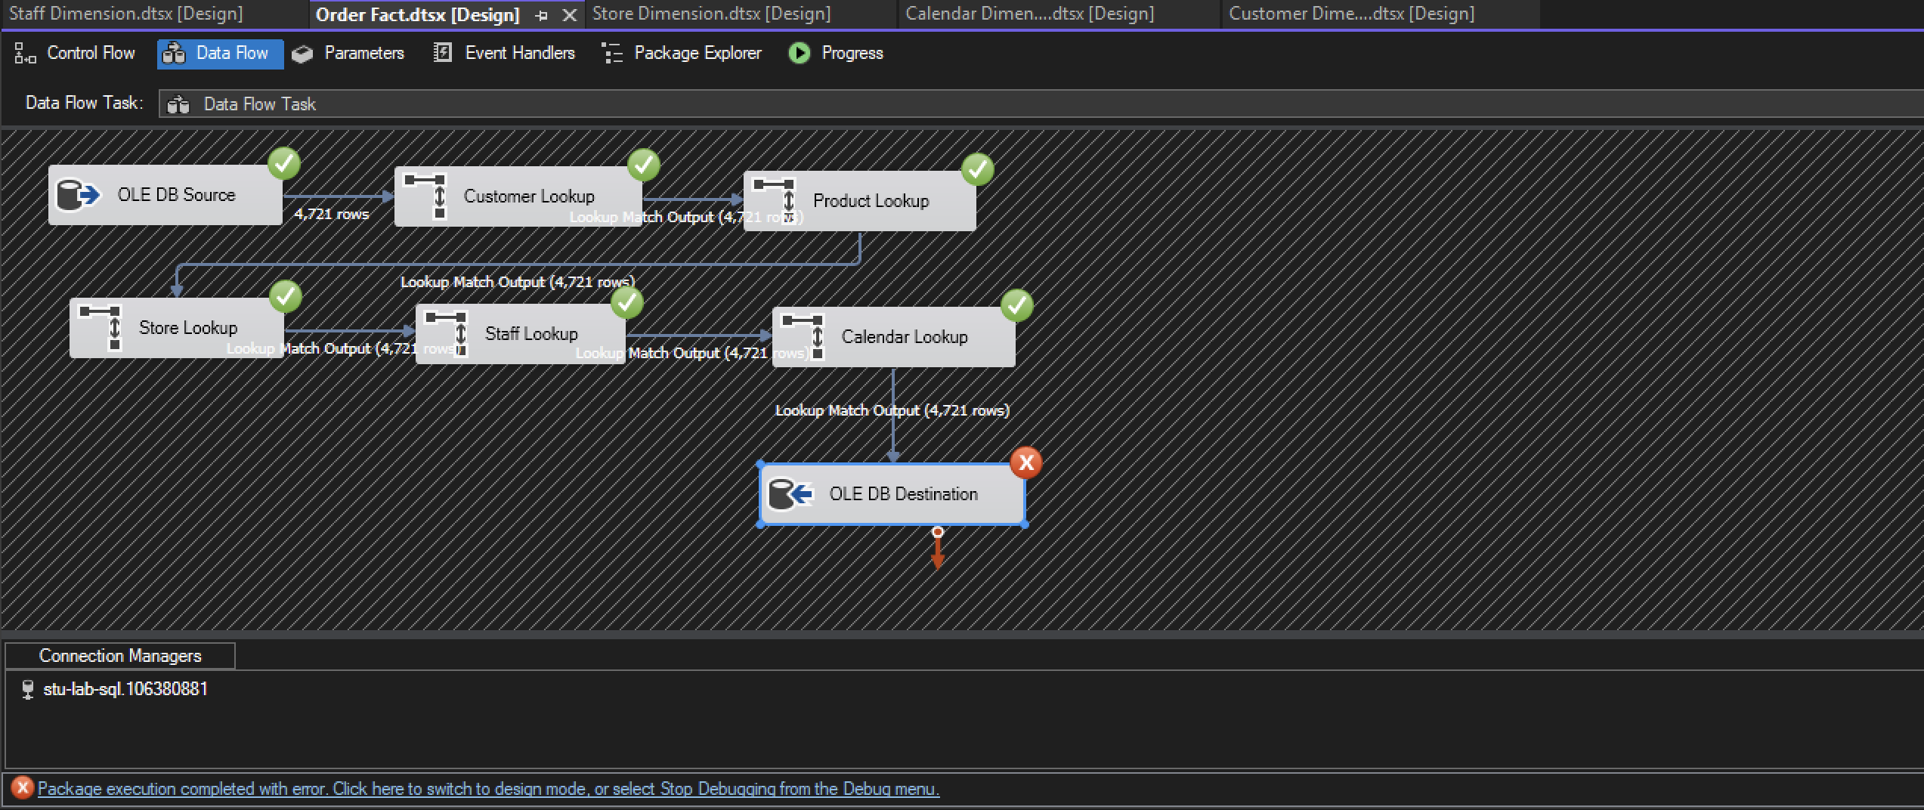
ETL

Slide 6
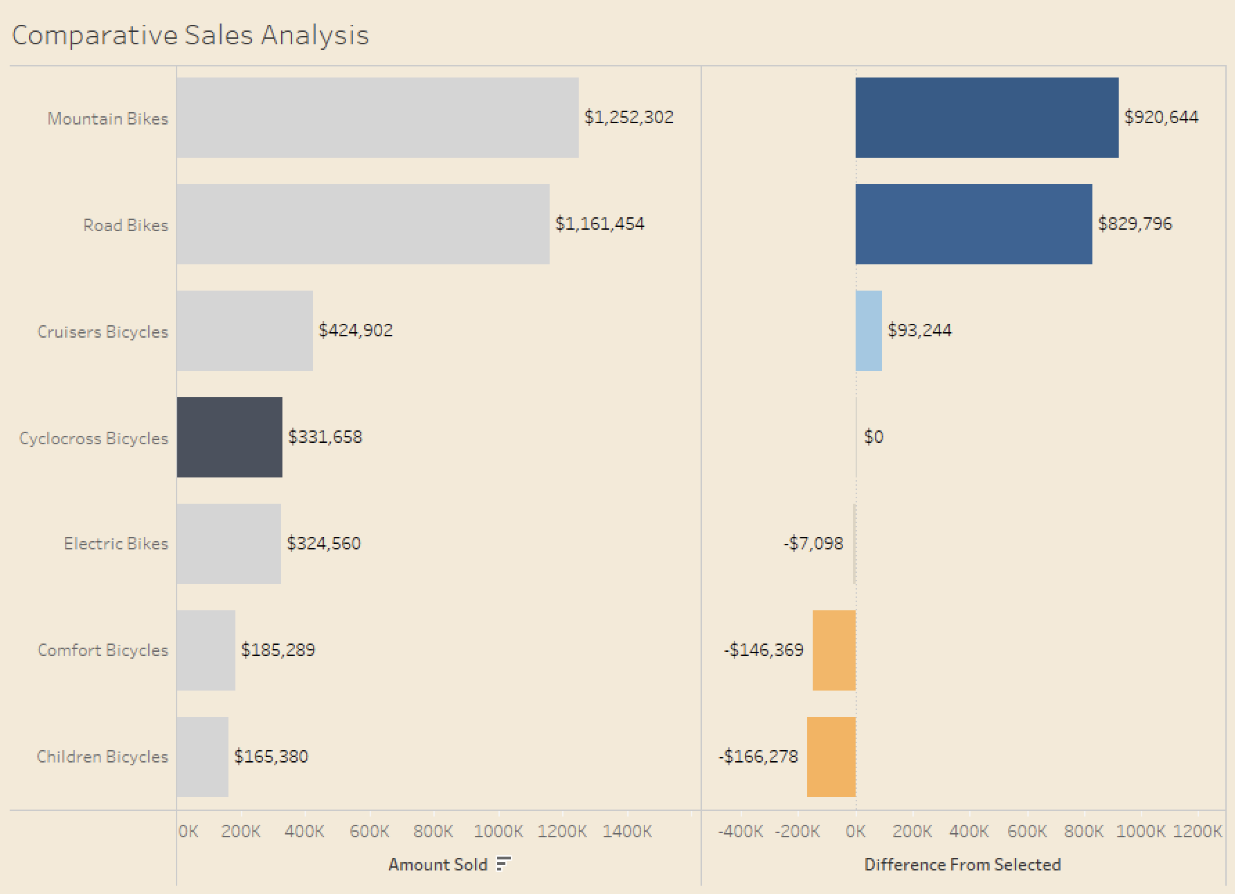
Comparative Sales Analysis between Categories
The user-controlled dual-axis bar chart, featuring parameters to highlight sales for a selected bike category while comparing it with others, stands as a sophisticated tool for nuanced business insights.
By allowing users to focus on a specific category through parameters, the visualization facilitates in-depth analysis of individual sales performances.

Slide 7
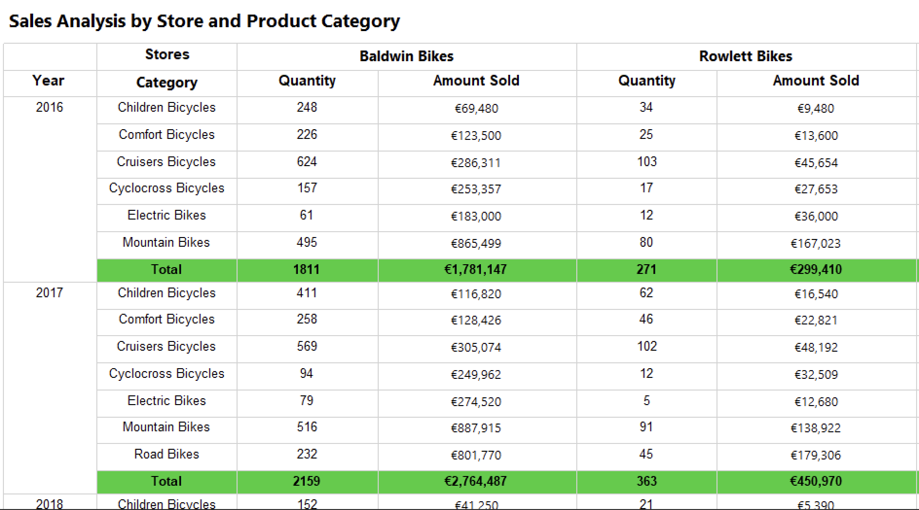
Reports
Sales Analysis by Store and Product Category
This report provides a comprehensive analysis of sales performance based on two dimensions: store and product category. It breaks down sales data to reveal how different stores are performing across various product categories.
This report is valuable for identifying high-performing stores and popular product categories.

Slide 8
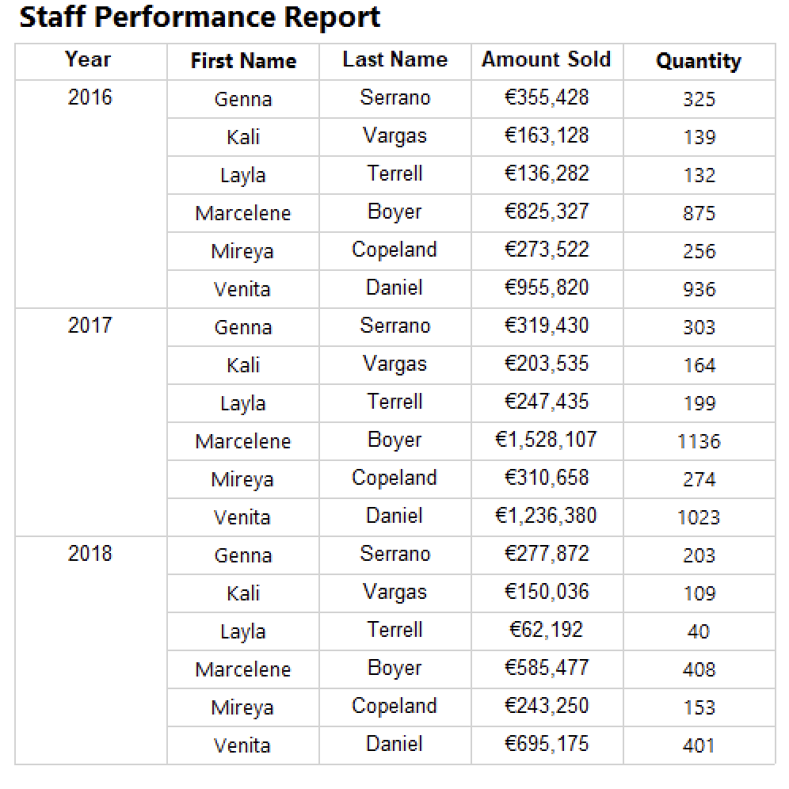
Staff Performance Report
This report assesses the sales performance of individual staff members within the organization. It includes metrics such as the number of sales, total revenue generated.
It provides insights into the contribution of each staff member to the overall sales goals of the business

Slide 9
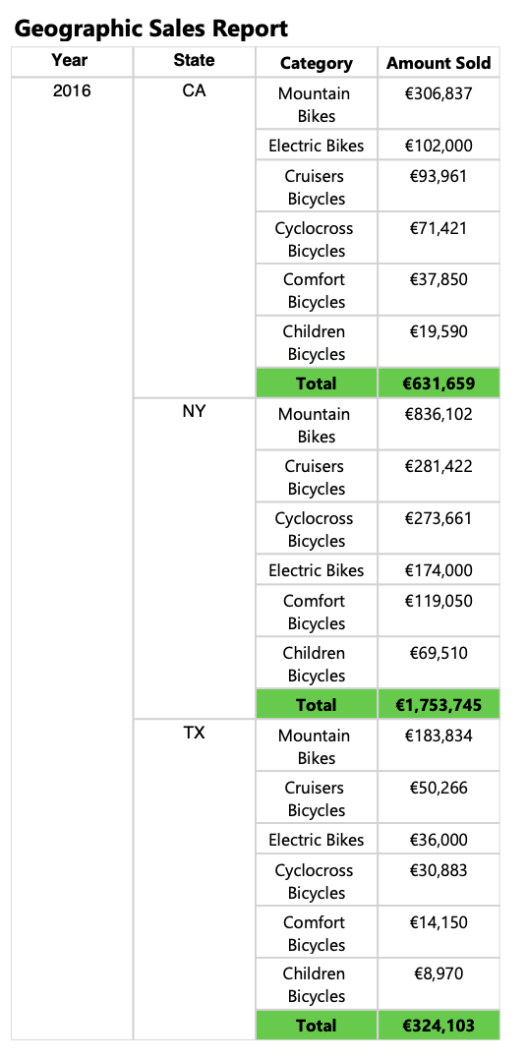
Geographic Sales Report
This report analyzes sales data based on geographical regions. It provides a breakdown of sales performance by state. This report is essential for identifying regions with high or low sales, understanding regional preferences, and tailoring marketing strategies to specific geographic areas.
It aids in optimizing distribution, targeting regional promotions, and ensuring that the business is effectively meeting the demands of diverse markets.

Slide 10
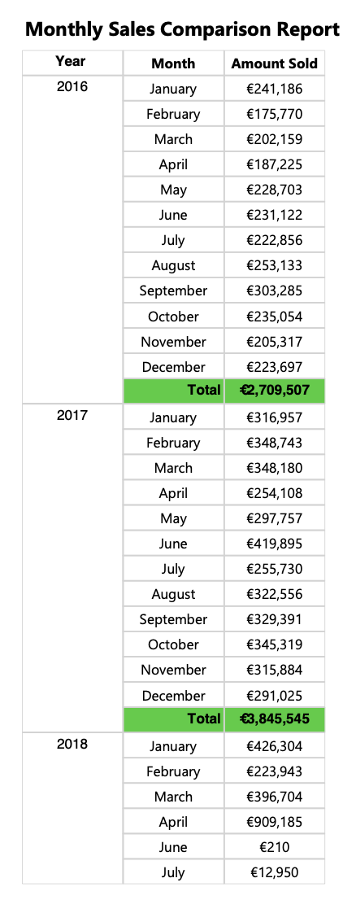
Monthly Sales Comparison Report
This report offers a comparative analysis of sales performance over different months. It aids in understanding seasonality, identifying peak sales periods, and evaluating the effectiveness of marketing campaigns or promotions over time .
By comparing monthly sales data, stakeholders can make informed decisions regarding inventory planning, marketing strategies, and overall business performance.

Slide 11
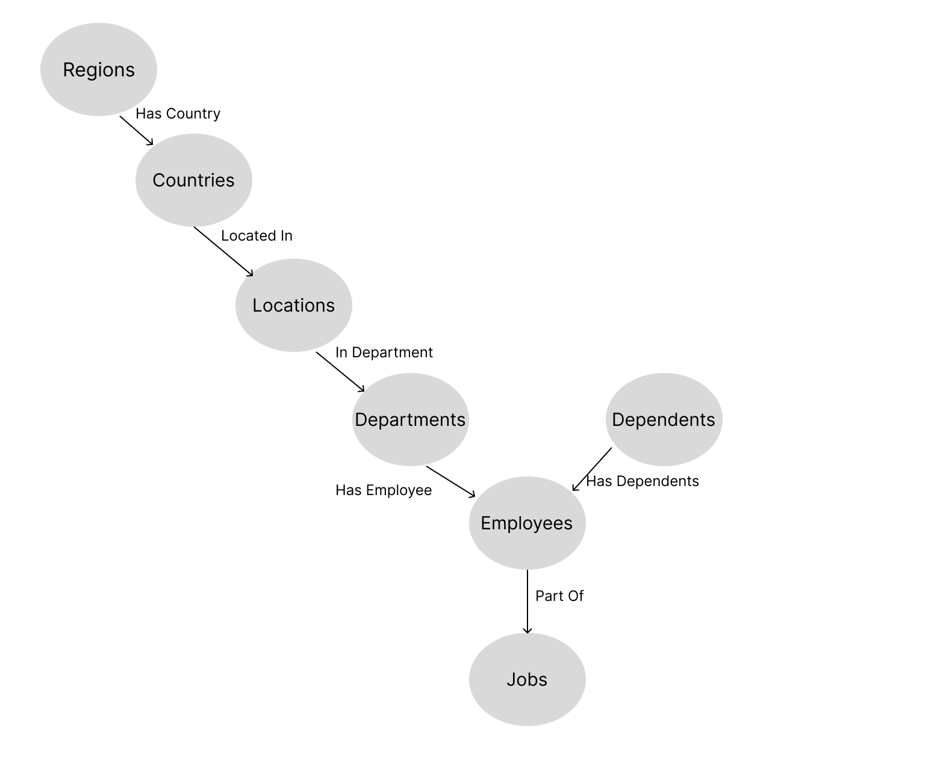
Graph Databases
To implement graph databases on using CQL on Neo 4j, we used a dataset from (SQL Sample Database, no date) which is a HR database of a company with several tables.
The CQL queries can be found in the appendix of this report. This section talks about the queries written and the importance to the business. Queries were written in both CQL and SQL
Graph Database Schema

Slide 12
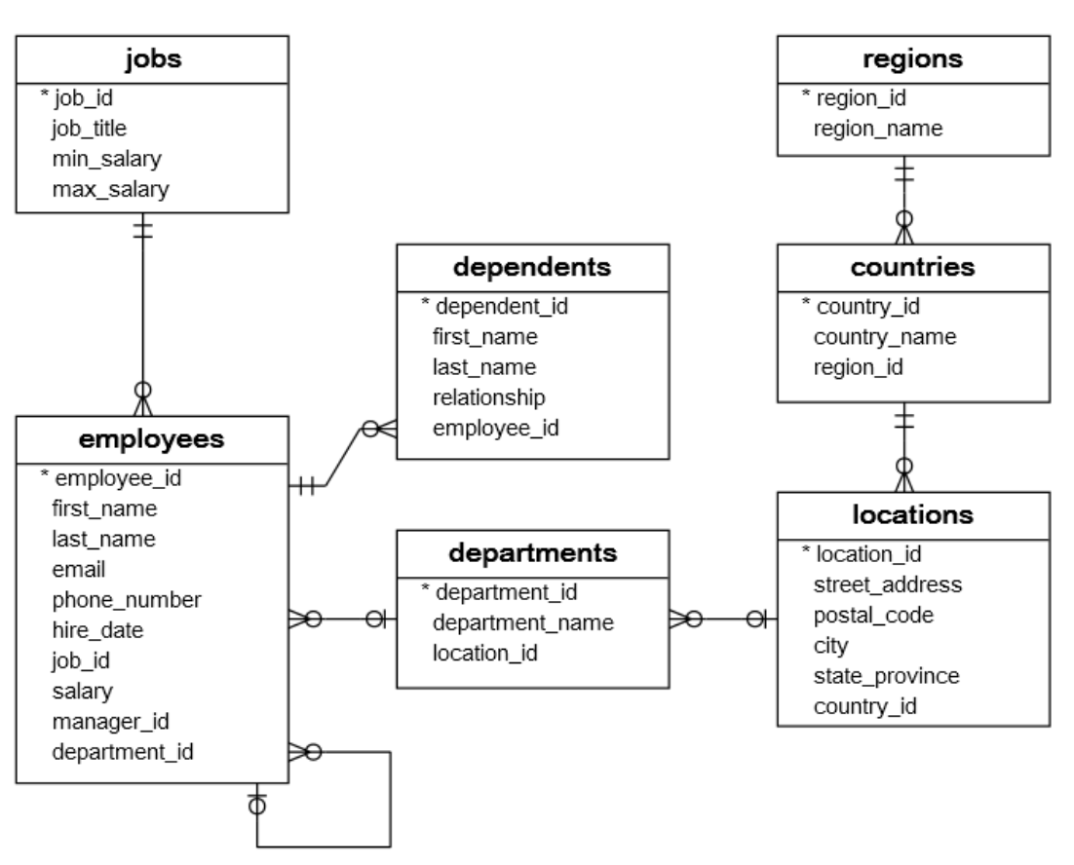
Relational Database Schema
List of employees and their department information
Average salary for each job title
List of departments with their numbers and the average salary
List of employees with dependents and the number of dependents
Total number of employees in each department
Max salary in each department
Employee information where salary is greater than the average salary
Relational Database Schema

Slide 13
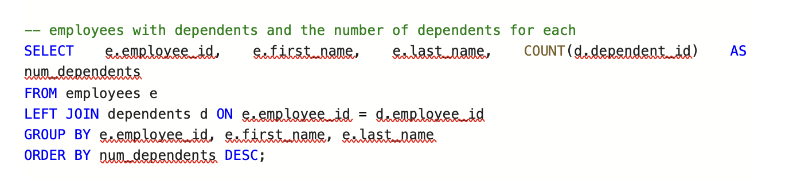
This SQL query retrieves information about employees and the number of dependents for each employee.
The results are grouped by employee ID, first name, and last name, and then ordered in descending order based on the number of dependents.

Slide 14

The result set shows employees along with the number of dependents each employee has.

Slide 15
Conclusions
The development of the data warehouse and the creation of reports align with the company's vision of leveraging data for strategic decision-making.
The insights gained from these reports empower key stakeholders to optimize various aspects of the business, resulting in improved sales, enhanced customer satisfaction, and streamlined operations.
Also, the use of CQL and SQL in writing queries showed us differences in how both databases operate and their advantages and disadvantages

Slide 16
Bibliography
SQL Sample Database (no date).
Available at: https://www.sqltutorial.org/sql-sample-database/ (Accessed: 9 December 2023).
SQL Server Sample Database (no date).
Available at: https://www.sqlservertutorial.net/sql-server-sample-database/ (Accessed: 9 December 2023).

Slide 17
THANK YOU

